Slide 1
HTTP
The Hypertext Transfer Protocol (HTTP) is a protocol used mainly to access data on the World Wide Web. HTTP functions as a combination of FTP and SMTP.
Topics discussed in this section:
HTTP Transaction
Persistent Versus Nonpersistent Connection
27.<number>

Slide 2

Note
HTTP uses the services of TCP on well-known port 80.
27.<number>

Slide 3
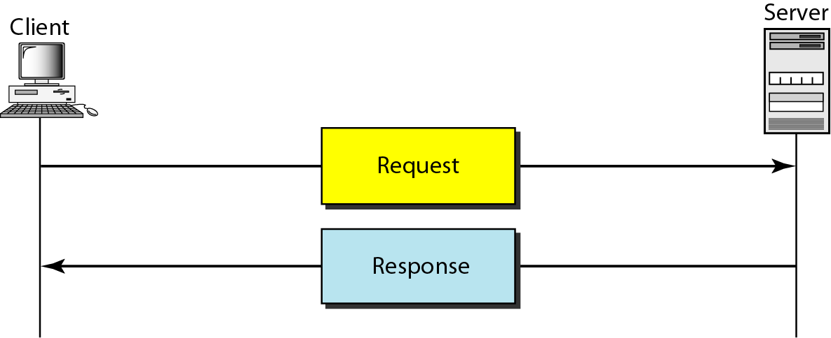
Figure 27.12 HTTP transaction
27.<number>

Slide 4
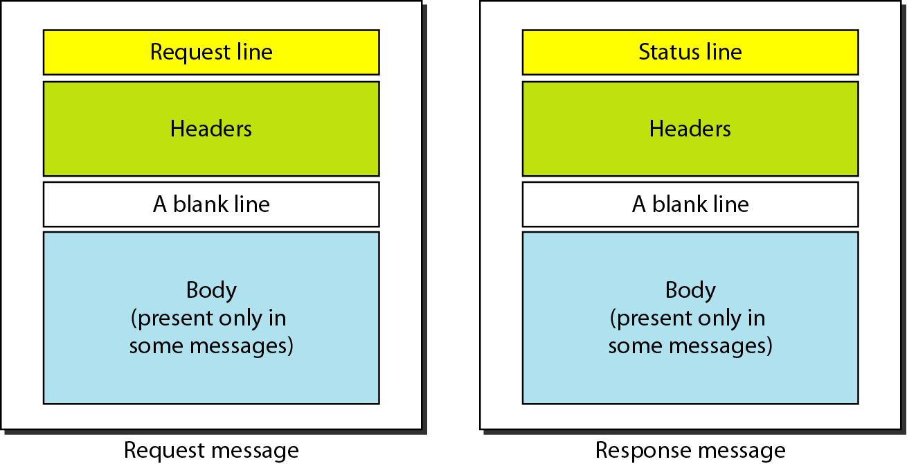
Figure 27.13 Request and response messages
27.<number>

Slide 5
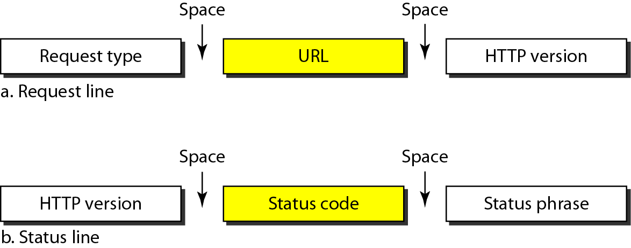
Figure 27.14 Request and status lines
27.<number>

Slide 6
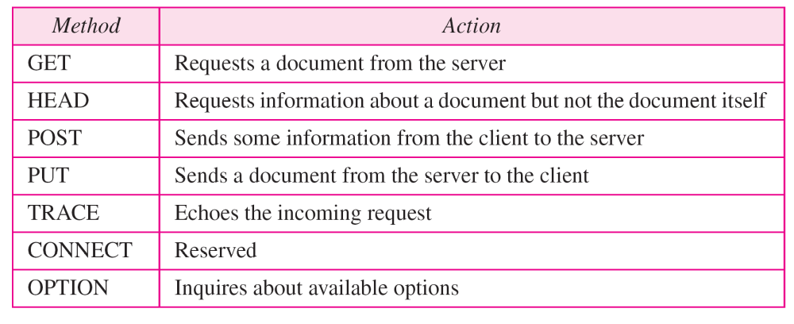
Table 27.1 Methods
27.<number>

Slide 7
Table 27.2 Status codes
27.<number>

Slide 8
Table 27.2 Status codes (continued)
27.<number>

Slide 9
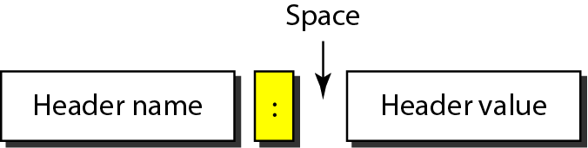
Figure 27.15 Header format
27.<number>

Slide 10
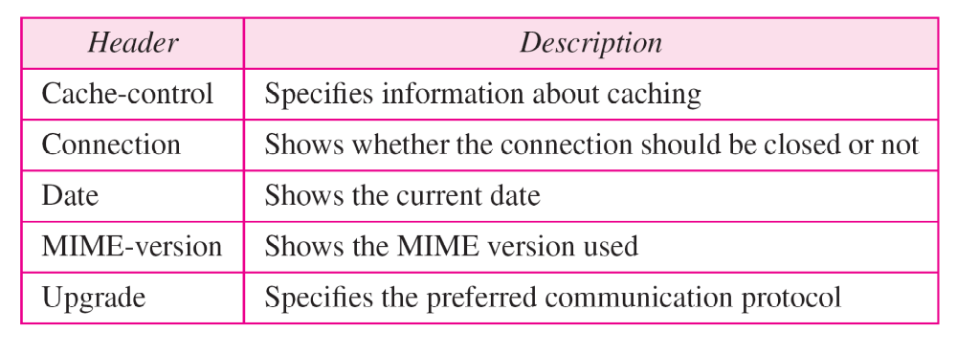
Table 27.3 General headers
27.<number>

Slide 11
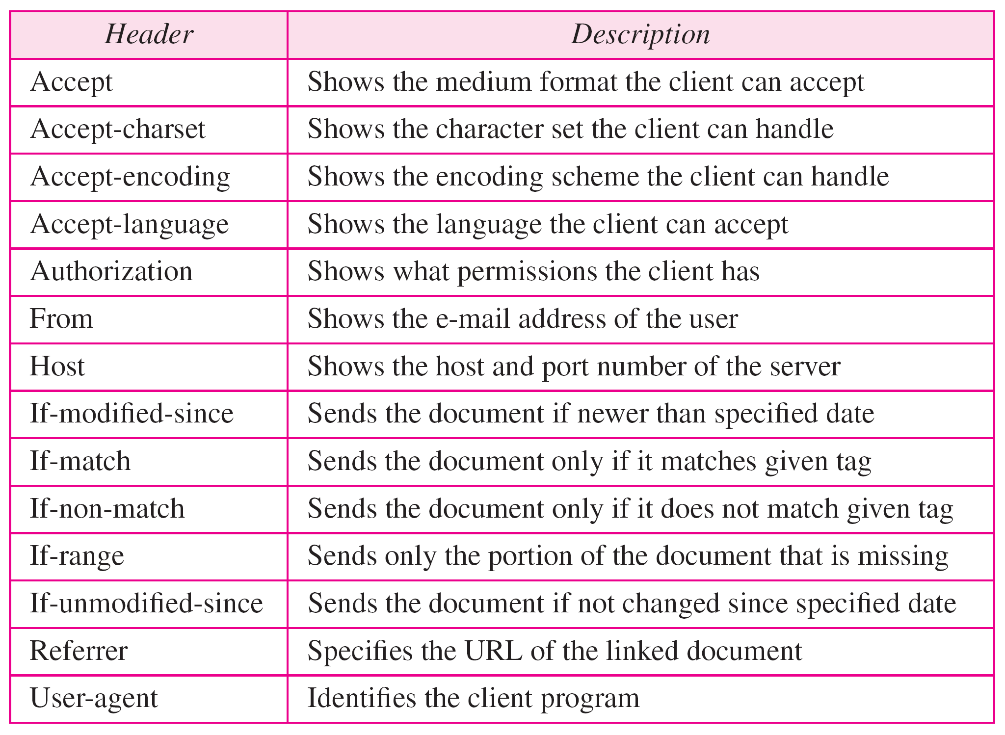
Table 27.4 Request headers
27.<number>

Slide 12
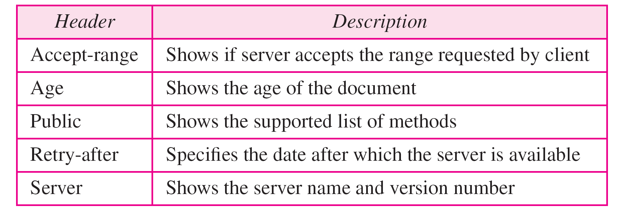
Table 27.5 Response headers
27.<number>

Slide 13
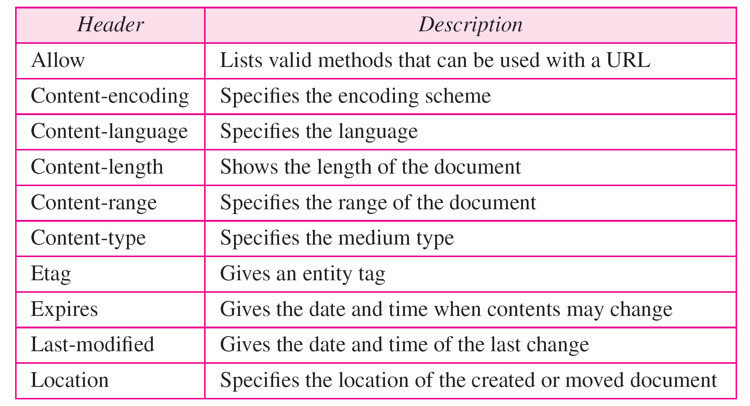
Table 27.6 Entity headers
27.<number>

Slide 14
Example 27.1
This example retrieves a document. We use the GET method to retrieve an image with the path /usr/bin/image1. The request line shows the method (GET), the URL, and the HTTP version (1.1). The header has two lines that show that the client can accept images in the GIF or JPEG format. The request does not have a body. The response message contains the status line and four lines of header. The header lines define the date, server, MIME version, and length of the document. The body of the document follows the header (see Figure 27.16).
27.<number>

Slide 15
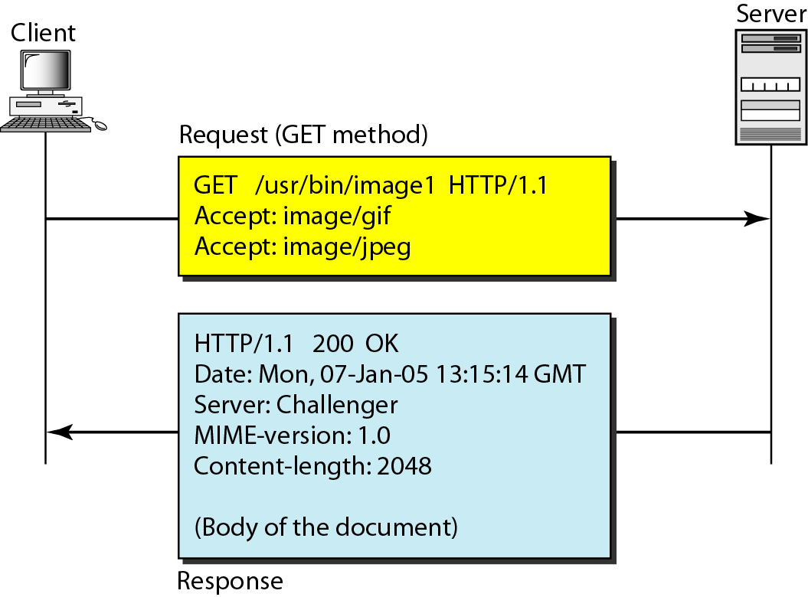
Figure 27.16 Example 27.1
27.<number>

Slide 16
Example 27.2
In this example, the client wants to send data to the server. We use the POST method. The request line shows the method (POST), URL, and HTTP version (1.1). There are four lines of headers. The request body contains the input information. The response message contains the status line and four lines of headers. The created document, which is a CGI document, is included as the body (see Figure 27.17).
27.<number>

Slide 17
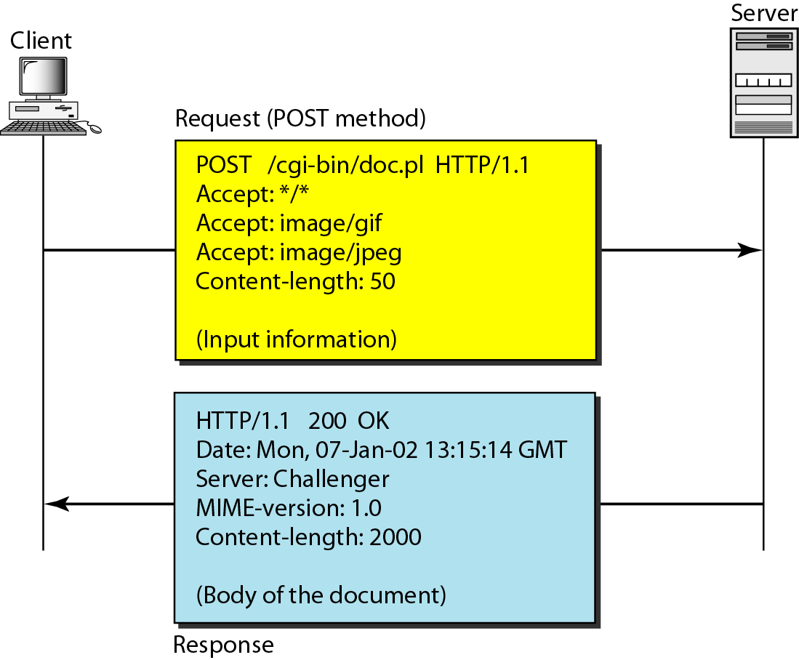
Figure 27.17 Example 27.2
27.<number>

Slide 18
Example 27.3
HTTP uses ASCII characters. A client can directly connect to a server using TELNET, which logs into port 80 (see next slide). The next three lines show that the connection is successful. We then type three lines. The first shows the request line (GET method), the second is the header (defining the host), the third is a blank, terminating the request. The server response is seven lines starting with the status line. The blank line at the end terminates the server response. The file of 14,230 lines is received after the blank line (not shown here). The last line is the output by the client.
27.<number>

Slide 19
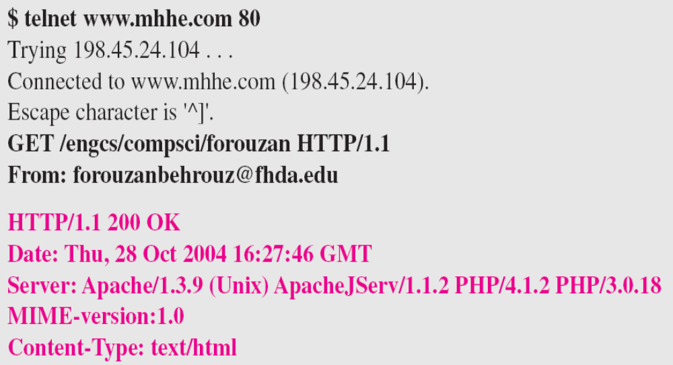
Example 27.3 (continued)
27.<number>

Slide 20
Note
HTTP version 1.1 specifies a persistent connection by default.
27.<number>

